Slide 1
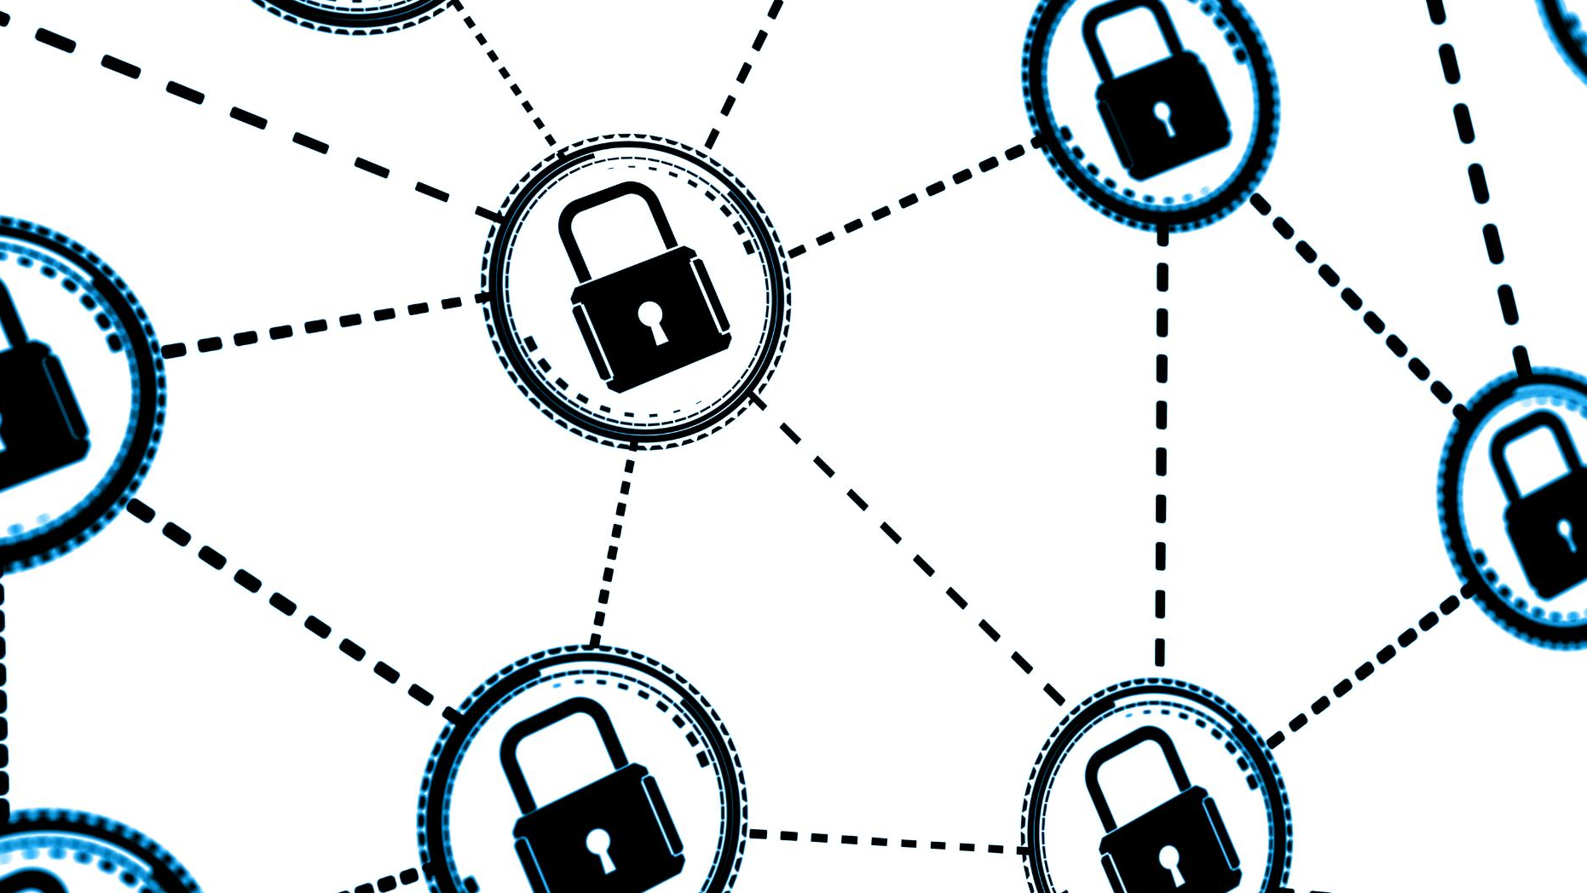
Transactional analysis
Understanding findings in sample file.

Slide 2
Discussion Topics
Data Analysis & Key Findings
Additional Data to Enhance Fraud Detection
Fraud & Chargeback Prevention Recommendations

Slide 3
Data Analysis & Key Findings

Slide 4
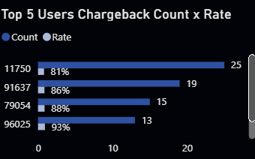
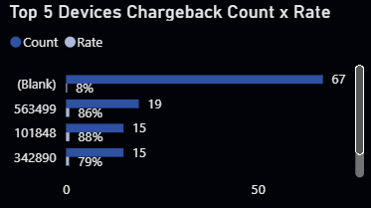
High-risk users & devices
The top 5 users account for disproportionately high chargeback rates (81%–93%), despite being a small fraction of total transactions.
Similarly, a handful of devices show both elevated chargeback counts and rates (up to 93%).

Slide 5
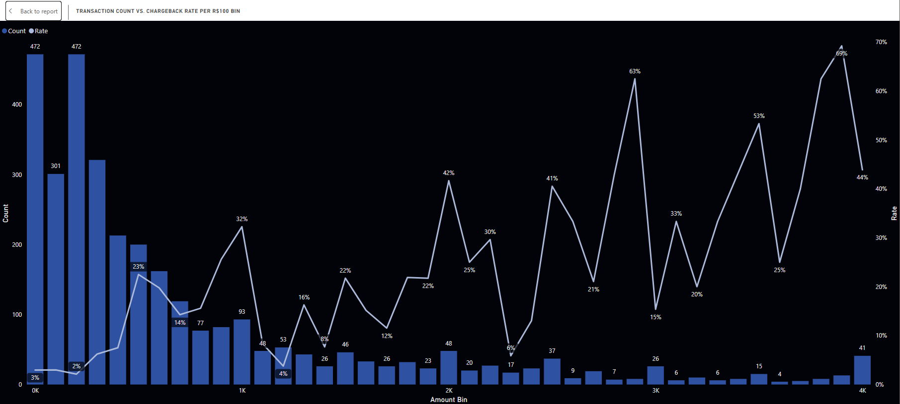
Amount Based “Test and Hit” Patterns
Chargeback frequency peaks in low‑value bins (R$0–100 and R$100–200), then drops sharply, then briefly resurges at mid/high values, consistent with “test small amount → validate stolen card → commit larger fraud”.

Slide 6
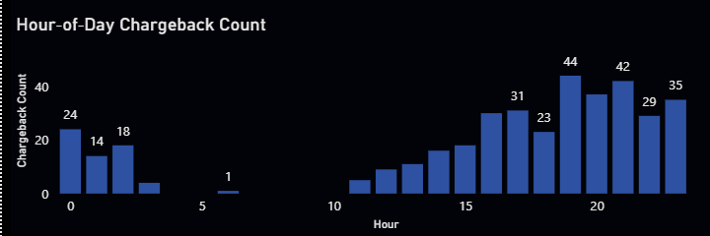
Temporal clustering
Chargebacks cluster in off‑peak hours, showing automated or scripted fraud tries when human review may be slowest.

Slide 7
Additional Data to Enhance Fraud Detection
Notes:
Information flow is equally important as money flow, as it ensures the proper processing of transactions. This section will explore how information moves through different stages of a transaction.

Slide 8
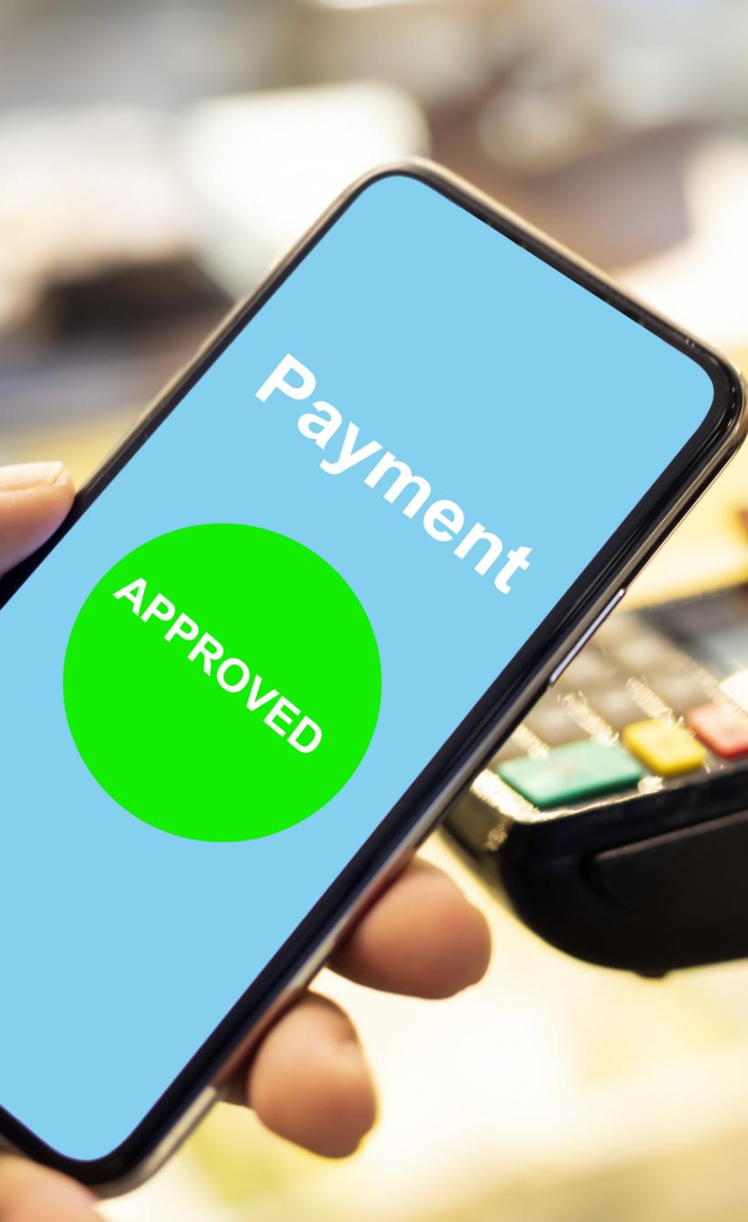
Future integrations
Device & Network Metadata
IP geolocation, VPN/proxy flags, browser fingerprint scores, and device fingerprinting.
Customer Profile & Historical Trends
Lifetime chargeback history, average order value per user, and account age.
Order Fulfillment Data
Shipping address velocity (same address used by multiple cards), carrier GPS stamps, and proof of delivery images.
External Fraud Feeds
BIN risk scores, global fraud deny lists, and peer network alerts from other merchants.

Slide 9
Fraud & Chargeback Prevention Recommendations

Slide 10
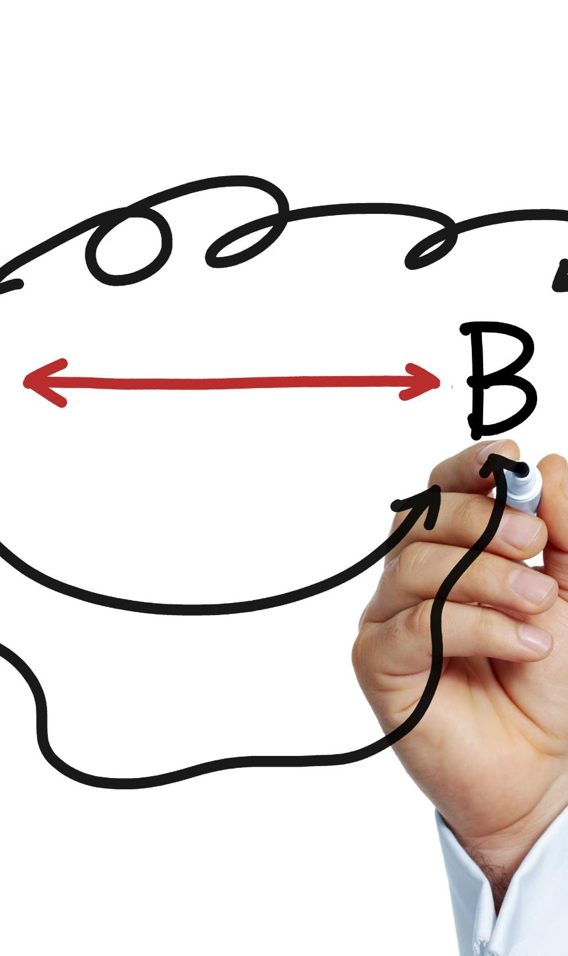
Fraud Prevention recommendations
Hybrid Rule-and-ML Engine
Enforce velocity/amount rules and time window restrictions.
Step-Up Authentication
Trigger 3D Secure or OTP verification for medium risk transactions (e.g., new device, high value purchase, or off hour order).
Manual Review & Rapid Response
Automatically route transactions above a specified risk threshold to a specialized team for the same day review.
Continuous Monitoring & Feedback Loop
Collect outcome data from disputes and chargeback representments to retrain the ML model and tune rule parameters, ensuring the system adapts to emerging fraud tactics.
Notes:
Sub-acquirers serve as intermediaries that provide services to merchants, often helping smaller businesses process payments without needing direct contracts with acquirers.

